Slide 1
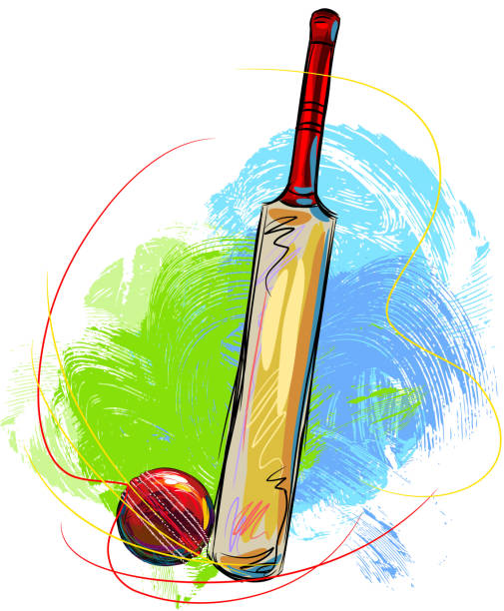
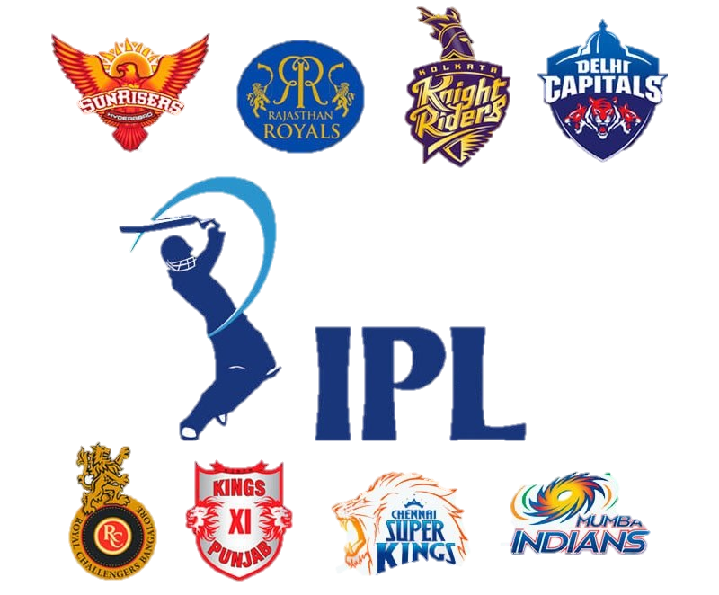

IPL DATA ANALYSIS AND PREDICTION

Slide 2
TABLE OF CONTENTS
DOMAIN- DATA SCIENCE AND MACHINE LEARNING
INTRODUCTION OF THE PROJECT
PROBLEM STATEMENT
PURPOSE
LITERATURE SURVEY
SYSTEM ARCHITECTURE
ALGORITHMS
PROJECT SURVEY
RESULT
IPL ANALYSIS
PREDICTION APP
SOFTWARE, LANGUAGES AND LIBRARIES
FUTURE WORK
MARKET POTENTIAL
CONCLUSION
REFERENCES

Slide 3
DOMAIN – Data Science and Machine Learning
Machine Learning is the preferred technique of predicting or classifying information to assist folks in creating necessary selections.
Machine Learning algorithms are trained over instances or examples through that they learn from past experiences and analyze the historical knowledge.
TYPES OF MACHINE LEARNING
Supervised learning
Unsupervised learning
Reinforcement learning

Slide 4
Define measurable and quantifiable goals
Use this stage to learn about the problem
DEFINE OBJECTIVES
DATA PREPARATION
MODEL BUILDING
MODEL EVALUATION
MODEL DEPLOYMENT
Placing a finished machine learning model into live environment where it can be used for its intended purpose.
Normalization
Transformation
Missing values
Outliers
MACHINE LEARNING AS A PROCESS
Study model accuracy
Works better than the naïve approach or previous systems
Do the results make sense in the context of the problem
Data splitting
Features engineering
Estimating performance
Evaluation and model selection

Slide 5




INTRODUCTION OF THE PROJECT
IPL data analysis & prediction is a machine learning based model which will predict the result of ongoing matches by using different machine learning algorithms along with complete analysis of various aspects of the match.
By using this model teams or franchise can make strategies and implement for their benefits.
The main challenge for implementing this model is that the result of the match can change with in few balls so the prediction can vary highly due to this we need to this build a suitable model.

Slide 6

PROBLEM STATEMENT
The main objective is to predict the IPL Match Result that would be beneficial for the franchises and authorities who are at a position of decision making.
IPL has a large set of audience.
In cricket, particularly IPL is most watched and loved by the people, where no one can guess who will win the match until the last ball of the last over.
The main purpose of this research work is to find the best prediction model i.e. the best machine learning technique which will predict the match winner out of the two teams.

Slide 7

PURPOSE
The purpose of the application is to build an effective predictive modeling tool that can accurately predict the match outcome based on several different critical features that it takes from the user such as the target scorer, elements of the allotted overs, the total number of balls and wickets remaining.
The purpose is to find insights the player during the course of the season by visually analyzing all the basic features

Slide 8

LITERATURE SURVEY
The research paper of G.Sudhamathy helps to understand the different machine learning algorithms working principal and their implementation .
It creates the Model and Training dataset and helps to predict with the help of the model created.
The role of classification is clarify in the paper of Tejinder Singh it gives proper information or use of naive bias and linear regression.
They gives the proper knowledge of data collection and preparation also how to train the data and test the data is given by them which is more helpful.
The support vector machines brief idea is been taken from Aminul Islam Anik paper which is about players performance in this paper the idea about SVM system is given in detailed where the player performance prediction is given by collecting the old information or data.

Slide 9
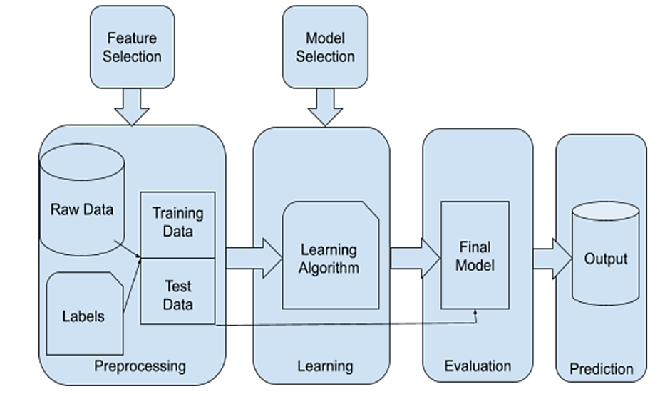
SYSTEM ARCHITECTURE
Data Acquisition
Data Pre-processing
Feature Selection
Training Classification Methods
Testing Data

Slide 10






USERS
SYSTEM A
PREDICTING WINNING TEAM
LOGISTIC REGRESSION
DATASETS
SYSTEM B

Slide 11

ALGORITHMS USED :

Slide 12
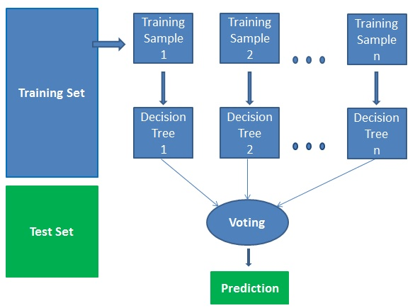
RANDOM FOREST ALGORITHM
Random Forest is a popular machine learning algorithm that belongs to the supervised learning technique.
It can be used for both Classification and Regression problems in ML.
It is based on the concept of ensemble learning, which is a process of combining multiple classifiers to solve a complex problem and to improve the performance of the model.
As the name suggests, "Random Forest is a classifier that contains a number of decision trees on various subsets of the given dataset and takes the average to improve the predictive accuracy of that dataset."
Instead of relying on one decision tree, the random forest takes the prediction from each tree and based on the majority votes of predictions, and it predicts the final output.
The greater number of trees in the forest leads to higher accuracy and prevents the problem of overfitting.

Slide 13

Why use Random Forest?
It takes less training time as compared to other algorithms.
It predicts output with high accuracy, even for the large dataset it runs efficiently.
It can also maintain accuracy when a large proportion of data is missing.
ADVANTAGES OF RANDOM FOREST
Random Forest is capable of performing both Classification and Regression tasks.
It is capable of handling large datasets with high dimensionality.
It enhances the accuracy of the model and prevents the overfitting issue.

Slide 14

LOGISTIC REGRESSION
Logistic regression is one of the most popular Machine Learning algorithms, which comes under the Supervised Learning technique.
It is used for predicting the categorical dependent variable using a given set of independent variables.
Logistic Regression is a significant machine learning algorithm because it has the ability to provide probabilities and classify new data using continuous and discrete datasets.

Slide 15
LITERATURE SURVEY
Dr. SUDHAMATHY’S RESEARCH PAPER
The research paper of G. Sudhamathy helps to understand the different machine learning algorithms working principles and their implementation. It creates the Model and Training dataset and helps to predict with the help of the model created. The model classifies the data and compares the results and gets accuracy which is the important one.
2. "PREDICTIVE MODELLING FOR INDIAN PREMIER LEAGUE USING MACHINE LEARNING TECHNIQUES" BY D. BALAKRISHNAN AND M. SANTHI.
This research paper discusses the application of machine learning techniques such as decision trees, support vector machines, and random forests for predicting IPL match outcomes.
3. "DATA MINING TECHNIQUES FOR IPL PREDICTION" BY R. R. MAHAJAN AND A. V. KULKARNI.
This paper explores the use of data mining techniques, including classification algorithms and association rule mining, to predict IPL match results and identify key factors influencing team performance.
4. "DATA ANALYTICS IN CRICKET: A STUDY ON PREDICTING IPL MATCH OUTCOMES USING MACHINE LEARNING" BY M. ANANDHAVALLI AND A. P. SUBASHINI.
The authors analyze IPL match data and employ machine learning algorithms to predict match outcomes. They evaluate the performance of classifiers such as decision trees, random forests, and naïve Bayes

Slide 16
PROJECT SURVEY
Prediction of IPL Match Outcome Using Machine Learning Techniques
Authors: Srikantaiah K C , Aryan Khetan , Baibhav Kumar , Divya Tolani , Harshal Patel
https://www.researchgate.net/publication/355061139_Prediction_of_IPL_Match_Outcome_Using_Machine_Learning_Techniques
Description :
With the help of this research paper we got the idea to build a IPL match prediction model, seeing the popularity and craze of the game keeping various factors affecting the game in consideration

Slide 17

RESULT
This model allows the users to analyze and predict the winner of the match by considering the current situation of the match.
It has easy to use interface which assists user to make prediction
The user will be presented with the probability of teams to win the match

Slide 18
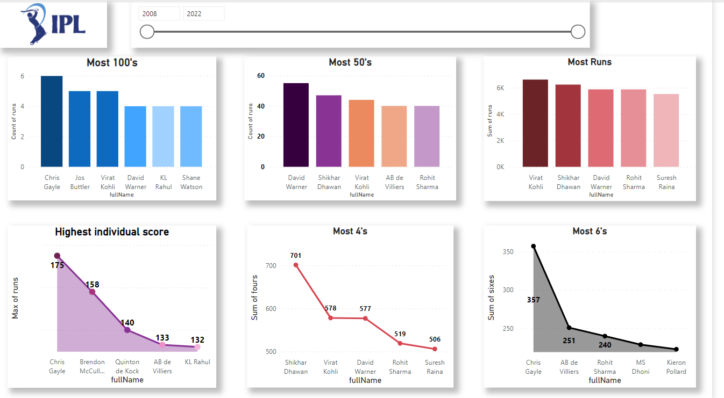
IPL ANALYSIS

Slide 19
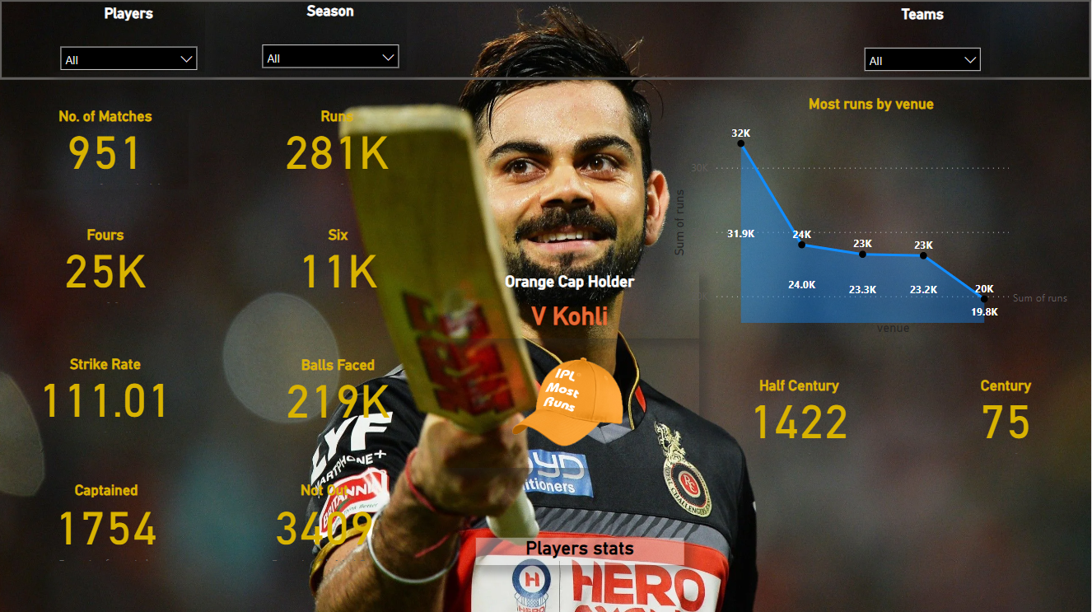
BATSMAN STATS

Slide 20
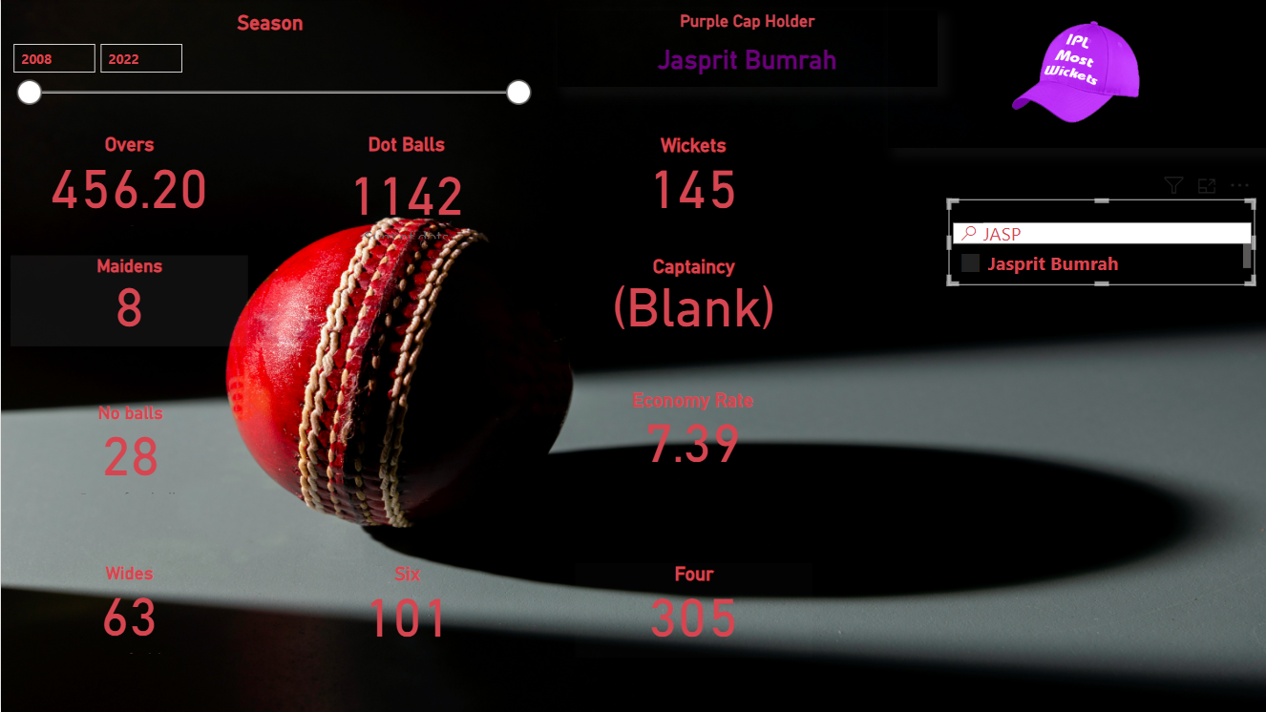
BATSMAN STATS

Slide 21
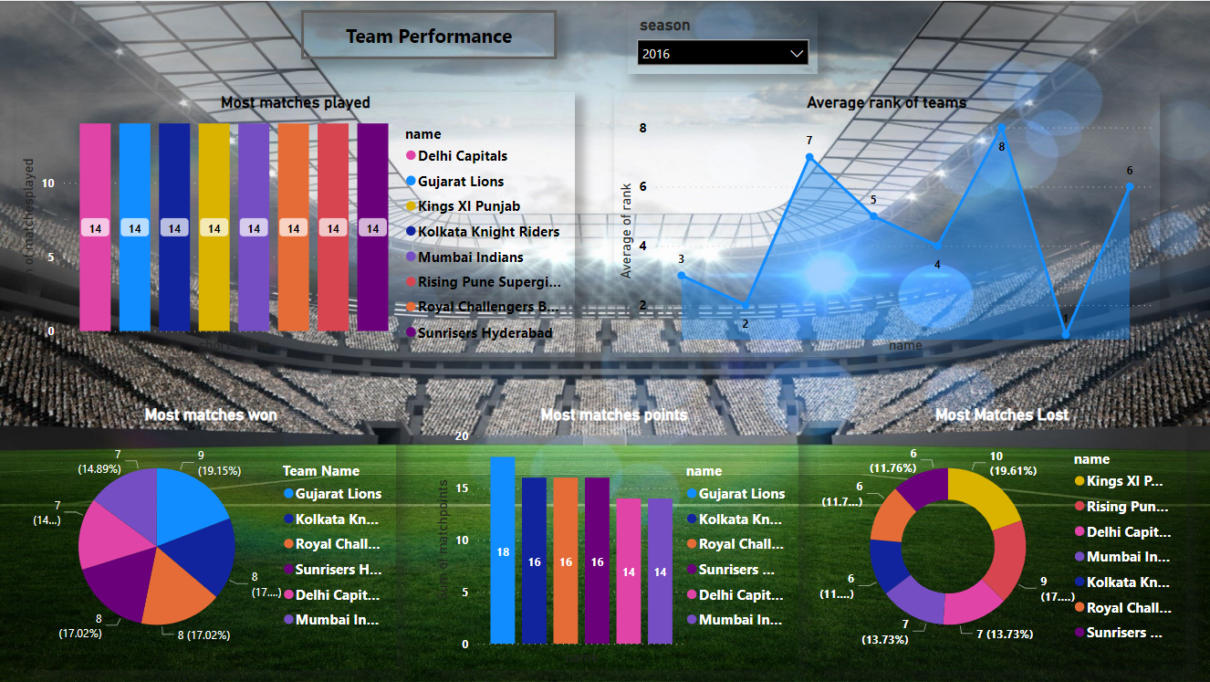
TEAM STATS

Slide 22
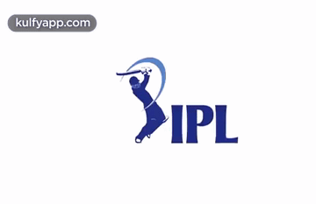
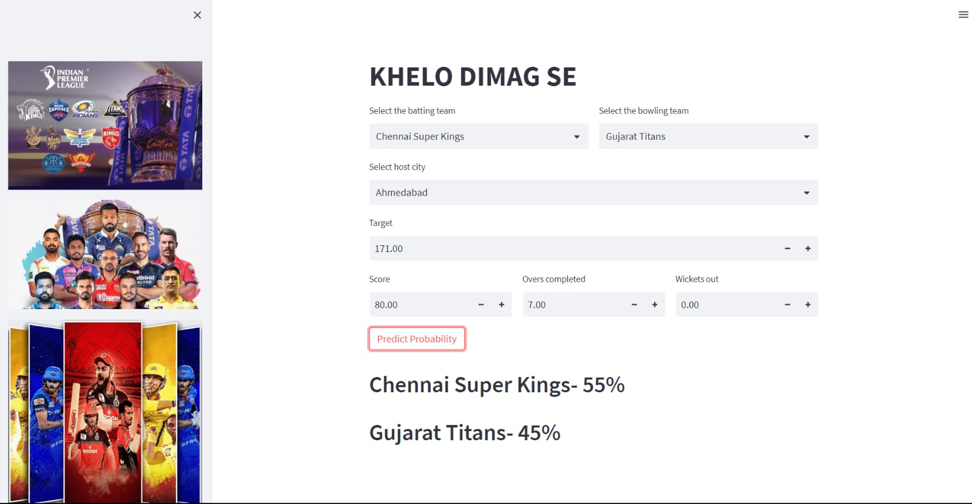
PREDICTION APP

Slide 23
SOFTWARES, LANGUAGES AND LIBRARIES
SOFTWARE
JUPYTER NOTEBOOK
POWER BI
PYCHARM
LIBRARIES
NumPy , Pandas, Matplotlib, Seaborn, Scikit Learn
PYTHON

Slide 24

FUTURE WORK
The data set can include some of the external factors like player injury, player fatigue, winning streak with a particular team, overall winning streak, average run scored by a team against a particular team in previous matches, etc.. and on the basis of these data we can try to do the prediction and to check to see the accuracy improves.
The prediction can also be done taking into consideration the performance of the players in the team like the total number of runs scored by a player in the tournament, the form guide of the player, the number of man of the match awards earned, etc.. rather than only using a high-level data about the different matches like toss winner, toss decision, home team, etc.

Slide 25
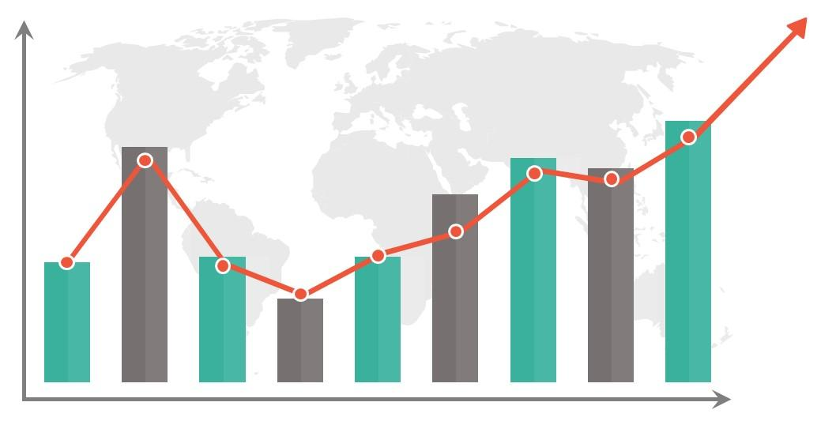
MARKET POTENTIAL
It has affected the betting industry in a very large amount
The Global Sports betting industry was worth USD 57.54 Billion in 2021, and it is predicted to increase at a CAGR of ~10% from 2020 to 2025. Sports betting generated $57.22 Billion in the handle and $4.2 Billion in revenue, in 2021 – jumps of 165% and 176% over 2020 respectively.
Estimates and reports from this gaming forum suggest that more than a 140Million People in India Play this online game regularly, pushing the number up to 370Million during the IPL season and the like which is approximately a 150% increase from a normal season

Slide 26

CONCLUSION
Predicting a winner in a sport such as cricket is especially challenging and involves very complex processes. But with the introduction of machine learning, this can be made much easier and simpler.
Factors that have a major impact on the outcome of an IPL match include the teams playing, the venue, the city, the toss winner and the toss decision.
We have analyzed IPL data sets and predicted game results based on player performance.

Slide 27

REFERENCES
G. Sudhamathy and G. Raja Meenakshi, “PREDICTION ON IPL DATA USING MACHINE LEARNING” ICTACT JOURNAL ON SOFT COMPUTING, OCTOBER 2020
Aminulislamanik, SakifYeaser, A.G.M. Imam Hussain, Amitabha Chakrabarty, “Player’s Performance Prediction in ODI Cricket Using Machine Learning Algorithms,”BRAC university,2019.
KilariJaswanth, KenchamArun, B Deva Deekshith, KilariAshwik, Pavithra J, “Analyzing and Predicting Outcomes of IPL Cricket Data,”IRJET Volume: 09 Issue: 03, Mar 2022.
D. Jyothsna, K. Srikanth, “Analyzing and Predicting outcome of IPL Cricket Data”, International Journal of Innovative Research in Science, Engineering and Technology,Vol. 8, Issue 4, April 2019
SiddharthSinha, PrakashTripathi, AakashVishwakarma, Prof. AmrutaSankhe, “IPL Win Prediction System To Improve Team Performance using SVM.,”International Journal of Future Generation Communication and Networking Vol. 13, No. 1s, (2020), pp. 17- 23
Ruchitha M and Dr. Preeti Savant, “IPL WINNER PREDICTION USING ML ALGORITHMS”,IJEASTVol. 6, Issue 9, January 2022 • RabindraLamsal and Ayesha Choudhary, “Predicting Outcome of Indian Premier League (IPL) Matches Using Machine Learning”, arXiv:1809.09813 [stat.AP] (September 2018)
S. Abhishek, Ketaki V. Patil, P. Yuktha and S. Meghana,“Predictive Analysis of IPL Match Winner using Machine Learning Techniques”,International Journal of Innovative Technology and Exploring Engineering, Vol. 9, No. 1, pp.430-435, 2019.
Vistro, Daniel, Leo Gertrude David,“The cricket winner prediction with application of machine learning and data analytics,”International Journal of Scientific and Technology Research, Volume 8, Issue 09, 2019.

Slide 28


Slide 29

PRESENTED BY :
Kaiwalya Sevekar - 61
Yash Padol - 50
Chandan Sinha - 07
Rizwan Shaikh - 57

